Slide 1
Optimization of Multi-Channel BCH Error Decoding for Common Cases
Russell Dill
Master's Thesis Defense – April 20, 2015

Slide 2
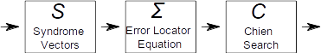
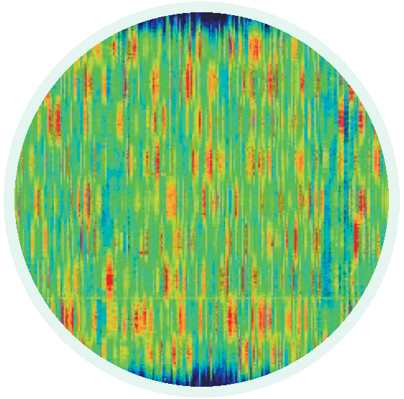
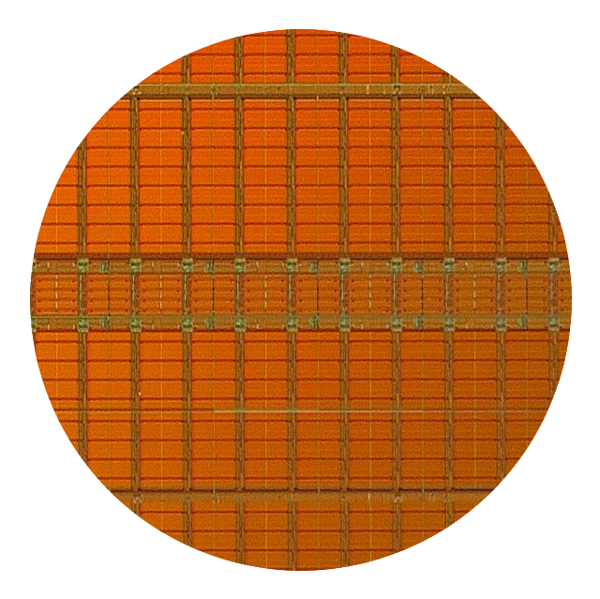
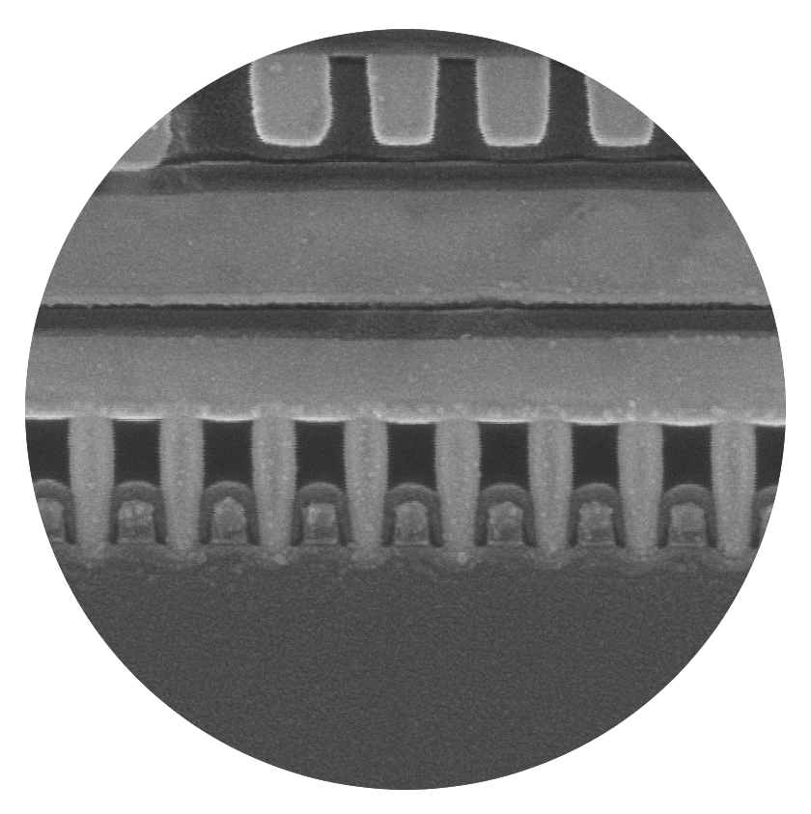
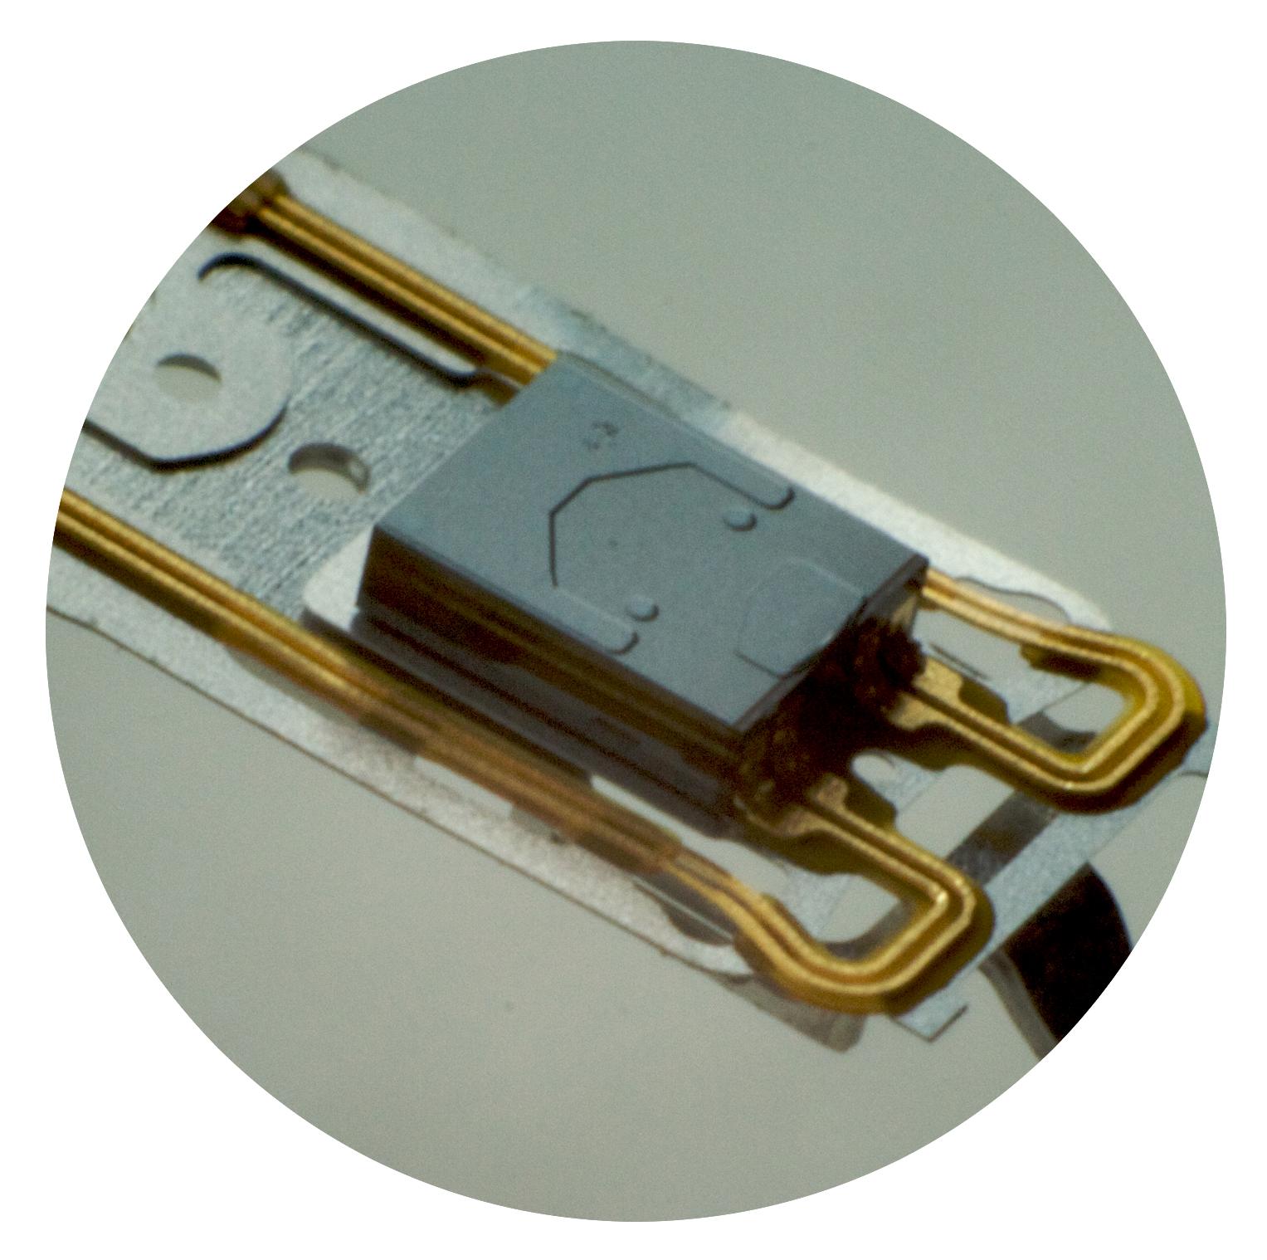
Bose-Chaudhuri-Hocquenghem (BCH)
BCH is an Error Correcting Code (ECC) and is used to correct errors in noisy communications channels or storage mediums
Allowing for noise (errors) enables the use of much faster communications channels and much denser storage mediums
Used in:
Wireless communication links
NAND flash storage
Magnetic storage
On-chip cache memories
DRAM memory arrays
Data buses

Slide 3
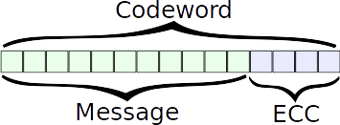
BCH Code
BCH is a configurable block based error correcting code (ECC)
Message is broken into fixed sized blocks and then each block is formed into a codeword
Redundant bits (ECC) are added to message to generate codeword
Size of codeword is configurable
Error correction capability is configurable
Redundant bits are used by receiver to detect and correct errors

Slide 4
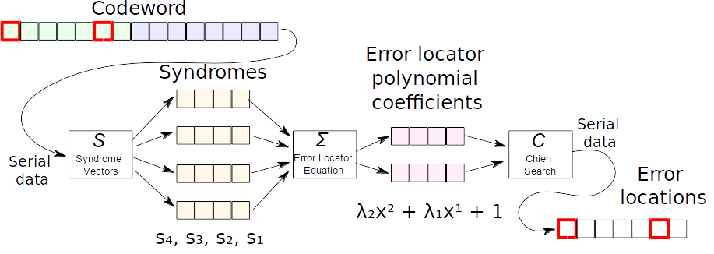
BCH Decoding
Decoding is broken into 3 independent stages
Errors

Slide 5
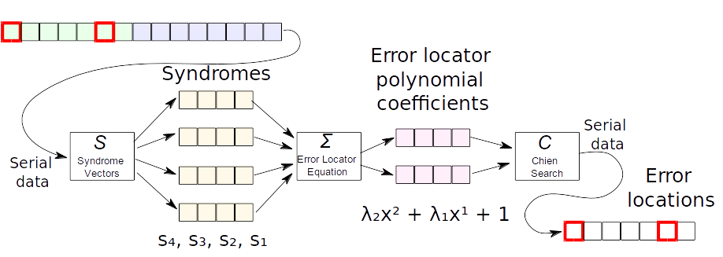
Syndrome Calculation
Breaks down received codeword into a set of vectors that depend only on the error locations, easiest stage of decoding
Syndromes evaluate to zero if no errors are present
Accepts data serially, outputs syndrome vectors once complete

Slide 6
Generate Error Locator Polynomial
Uses the syndrome vectors to calculate a polynomial whose roots give the error locations
Uses iterative algorithm known as Berlekamp-Massey
Outputs coefficients when complete

Slide 7
Factoring Error Locator Polynomial
Uses brute force algorithm know as Chien search
Roots give the locations of the errors
Errors in message can now be corrected
Outputs stream indicating error locations, 0 for no error, 1 for error

Slide 8
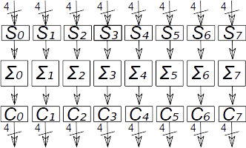

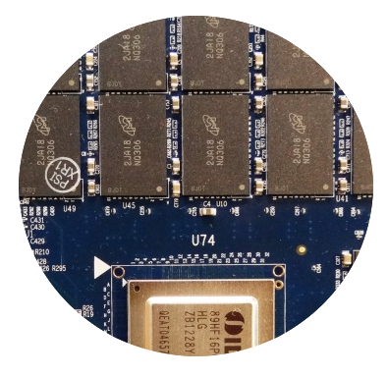
Multi-channel BCH Decoding
Multi-channel decoders combine multiple decoders in parallel
8 syndrome units, 8 error locator units, 8 root solving units
Increases throughput
Can be fed by multiple parallel communications or storage channels
Can be fed by an interleaved code
Typically used in communications to spread error bursts across multiple blocks
x8

Slide 9
Related Work
BCH decoding is a heavily researched area
Invented in 1959, widely used today
Almost all of that research has focused on improving standalone encoders and decoders
Research has concentrated on improvements to both efficiency and throughput

Slide 10
Existing Work to Improve Throughput
x4
x4
Bit-parallel operation
Previous BCH decoders operated 1 bit at a time
Best demonstrated by Hwang (1991)
Syndrome unit calculates multiple input bits in parallel
Chien root finding unit calculates multiple output bits in parallel
Intermediate stages require no modification as they pass data as a unit in a single clock cycle
Advantage – Flexible, easy to apply to existing designs
Disadvantage – Lowers clock rates, increases logic complexity

Slide 11
Existing Work to Improve Throughput
Multi-channel operation
Abraham et al. (2010) shows an example in flash memory storage system
Shi et al. (2004) shows an example of interleaving in communications links
Advantage – Scales all properties linearly
Disadvantage – Requires modification of design, requiring either multiple input channels or an interleaved code
x8

Slide 12
Syndrome Efficiency Improvements
Lin and Costello (1983) have demonstrated a mathematical relation between syndrome vectors
Relation can be used to calculate only a subset of the syndromes, and then perform a simple expansion step to recover the rest
Some syndromes can be calculated by a more efficient method (Lin and Costello, 1983)
Bit-parallel optimizations for LFSR can be applied to syndrome computation (Pahri, 2004)
Most common syndrome computation method is LFSR
Bit-parallel operation is common to increase throughput
Notes:
Highlight stage and problem to solve

Slide 13
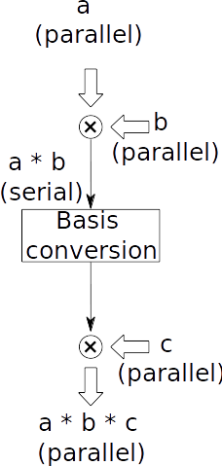
Error Locator Improvements
Jamro (1997) shows how the number of Berlekamp-Massey iterations can be reduced by intelligently loading the initial state
Jamro also observes the necessity to multiply 3 factors and shows a more efficient solution by pairing 2 serial multipliers of different basis
One multiplier accepts parallel input, gives serial output
The other accepts serial input, gives parallel output
Can operate simultaneously if basis rearrangement is performed serially
Requires novel serial basis conversion circuit

Slide 14
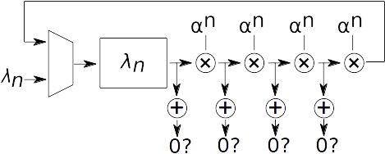
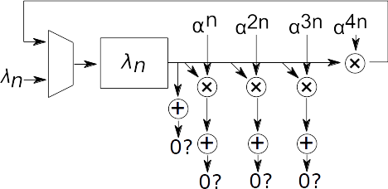
Chien Efficiency Improvements
Bit-parallel Chien search improvements
Large bit-parallel Chien search circuits consume a large amount of decoder area and power
Chen and Parhi (2004) demonstrate a group matching scheme that can apply to Chien circuits and reduce logic complexity by 22%
Yang, Chen, and Chang (2013) demonstrate the relative cost of implementing multiplication serially or in parallel
Serial multiplication
Parallel multiplication

Slide 15
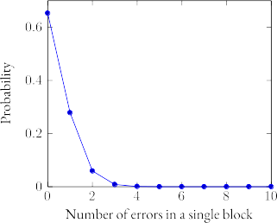
Our Observation
Most BCH decoder capability goes unused
Chance of entire decoder being used is 1/30 billion
In multi-channel configuration, on average only 1/3 of decoders are required
Remaining blocks contain no errors
Eventually, full decoder will still be required
Presents great opportunity for improvement

Slide 16
Our Observation
Majority of decoder capacity goes unused
(on average)
Questions?

Slide 17
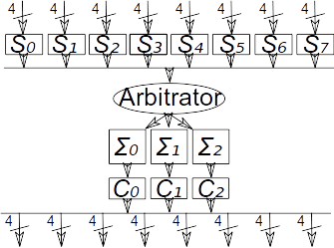
Our Approach
Apply ideas to multi-channel decoder
Allow possibility that not enough hardware is available right now (leads to performance penalty)
We still include at least 1 full decoder
Resize remainder of decoders
Syndromes (S) indicate error vs no error
All channels must undergo syndrome, but we can eliminate later stages
Include arbitrator to select first available unit
Reduce!
Reduced units

Slide 18
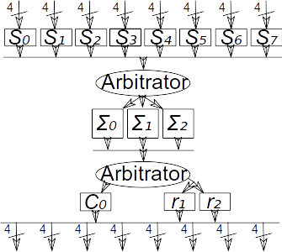
Our Approach
Can we do better?
After error locator (Σ), we know the error count
Single error blocks can be solved directly since they are of the form: λ₁x¹ + λ₀
Create reduced root locator (r) to replace expensive Chien units (C)
Add second arbitrator to select correct type of root solver based on error count
Simplify!
Simplified units

Slide 19
Implementing the Reduction in Hardware Blocks
Large percentage of blocks contain zero errors
Calculate the probability that a block contains zero errors based on BER, p, and block size, n:
Choose number of units such that there is only a small chance (miss rate) that insufficient hardware is available
In example on right, 3 error locator units are chosen as there is a less than 2% chance of 4 or more blocks containing errors

Slide 20
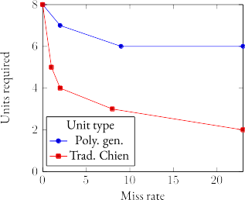
Choosing the Acceptable Performance Penalty
Miss rate is probability that at any given time, insufficient hardware is available
Miss rate is chosen based on trade-off between area savings and performance penalty
Same equations that determine probability of a certain number of errors within a block can be used to calculate the probability of a certain number of blocks containing errors
For our experiments, 2% was chosen as a good balance
Most gains are seen before the 2% mark
Largest gain
Less reward

Slide 21
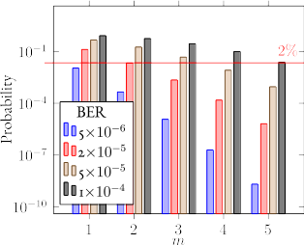
Choosing the Number of Error Locator Units
For each number of possible units, 1…channel count, plot probability that more than that count will be required
Find smallest count m below the 2% threshold
Implement that many error locator units (Σ)
Number of units required increases with targeted Bit Error Rate (BER)
For BER of 5·10⁻⁶, only 1 unit is required
For BER of 1·10⁻⁴, only 5 units are required

Slide 22
Architecture of Pooled Decoder
Pooling is used to connect to a full set of inputs to a reduced number of units
Pooled decoder inserts arbitrators between stages
Allows data to flow to first available decoding unit
In case of root solver (C/r), allows arbitrator to choose unit type based on error count
Still requires full set of syndrome units (small overhead)

Slide 23
Beyond Removing Units, Optimizing Units
Handling blocks with no errors allowed us to remove entire units
Blocks containing 1 error are still a common case
Error count is only known after error locator polynomial step (Σ)
To take advantage of this observation, we need to create special reduced root solvers (r)
Error polynomial will be of the form λ₁x¹ + λ₀
Full Chien requires: λ^{n}xn … λ₃x³ + λ₂x² + λ₁x¹ + λ₀
Direct solution with simple algebra

Slide 24
Reduced Root Solver
Solve and Simplify
Negation is a null operation
λ₀ is always 1
Provides direct, one step method to find root of error locator polynomial in the case of 1 error
However, the solution cannot be used to directly give an integer index to the error location because BCH codes are computed using an algebra known as finite fields
We need to learn a little about finite fields

Slide 25
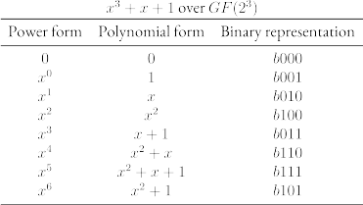
Finite Field Arithmetic
A finite field contains a finite set of elements, operations on any two elements produces another element in the field
Elements can be represented in different forms
Computation typically uses the binary representation of the polynomial form
All operations are performed modulo the generator polynomial, which defines the field
Moving from the polynomial form to the power form (index) is O(n) where n is the number of elements in the field (Typically in the thousands). Very costly

Slide 26
Finite Field Addition
Polynomials are added similarly to normal algebra
(x² + x) + (x + 1) = x² + 2x + 1
But the coefficient of each term is taken modulo the characteristic of the field, which for binary fields is 2, GF(2^{n})
x² + 2x + 1 = x² + 0x + 1 = x² + 1
This is the same as taking the XOR of the binary representation of the polynomial form
Addition is easy in finite fields!
Subtraction is defined to be the same as addition in finite fields (Negation is a null operation)
Addition:
x² + x
± x + 1
x² + x + 1 → x² + 1
110
xor 011
101

Slide 27
Finite Field Multiplication
To multiply two elements in power form, just add the exponents modulo the size of the field
x³ + x⁴ = x^{(3+4)%7} = x⁰
Multiplication in polynomial form is performed similarly to normal algebra, but taken modulo the generator polynomial:
(x + 1)(x² + x) = x³ + 2x² + x = x³ + x
And then to take it modulo the generator polynomial, we subtract it out:
(x³ + x) – (x³ + x + 1) = 1

Slide 28
Reduced Root Solver
Observation – we still need to cycle through each bit in the error output (Decoder streams error locations serially)
Rework equation again
Load register with λ₁
Multiply by x¹ each cycle
When register contains 1, we have multiplied by the correct power of x
We have counted the correct number of cycles and have reached the root/error location
Implement with LFSR, extends cheaply to multi-bit support

Slide 29
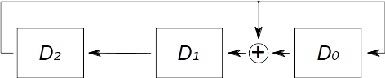
Usage of Linear Feedback Shift Register (LFSR)
Multiplies element by x¹, looping through the table
Operates on binary representation
Step 1: shift elements one to the left
Step 2: subtract generator polynomial if needed
×
o
o
x³ + 0x² + x + 1
Generator polynomial
LFSR can be modified with input/output
Multiply two values serially
Divide two values serially, producing a quotient and remainder
Used for many BCH operations

Slide 30
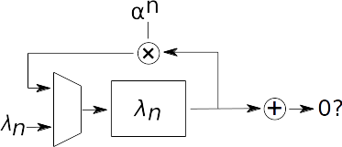
Comparison with Chien Search
Brute force method of finding roots
Loads registers with coefficients (λ_{n}) at first cycle (mux used to select)
Multiplies by α^{n} (constant) each subsequent cycle
n indicates coefficient index
t (number of errors that can be corrected) blocks are required per channel, which is also the number of coefficients
Requires t registers, muxes, and parallel multipliers. Expensive
Sums output of all blocks and compares result with 0 to detect roots
Portion of Chien root finder,
duplicated t times

Slide 31
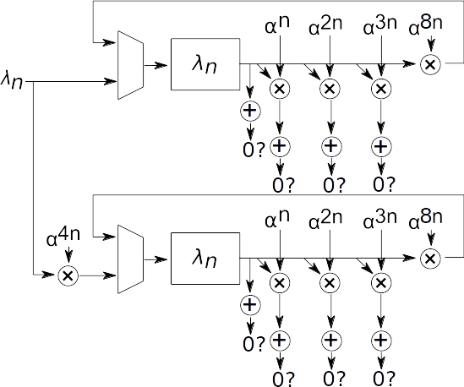
Comparison with Chien Search
Bit-parallel operation is scales at a rate beyond linear because of long delays and fanout requiring register duplication
Diagram demonstrates hardware necessary to operate on 8 bits in parallel
Parallel implementation of reduced root solver only requires 1 LFSR
Output of LFSR is compared against 8 constants per cycle
LFSR is advanced 8 steps per cycle
9 multipliers
2 multiplexers
2 registers
× t

Slide 32
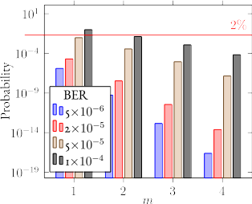
Choosing the Correct Number of Root Solvers
Similar to calculation of number of error locator units required
Instead we looks at blocks with more than 1 error (instead of 1 or more)
Blocks with 1 error can be served by reduced root solver
Blocks with more errors need Chien search
Calculate probability that more that m Chien units will be required
Plot and choose minimum number of units below 2% threshold

Slide 33
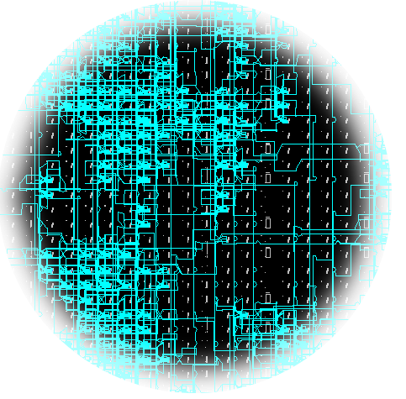
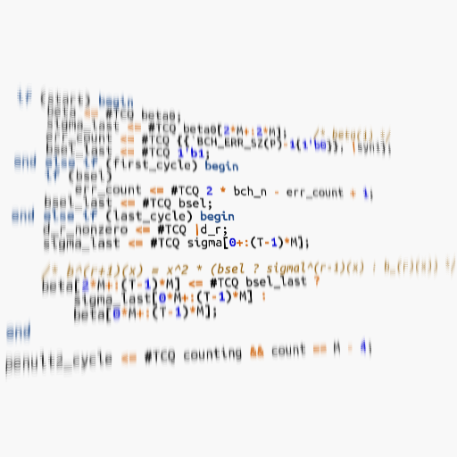
Experimental Setup
Implemented pipelined BCH decoding architecture in Verilog (baseline)
Target Virtex-6 FPGA, 200MHz timing for comparisons
Create pooled architecture with arbitrators
Make parameters compile time configurable for testing many configurations
Run Place & Route of design for the target, examine results to determine area for the chosen parameters

Slide 34
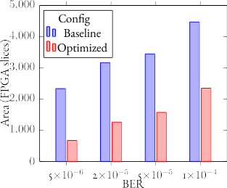
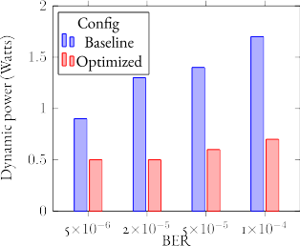
Area Optimized Decoder Results
Results of applying our ideas to a set of multi-channel BCH decoder configurations
We allow a 2% performance impact
We gain
47%-71% area savings
44%-59% dynamic power savings

Slide 35
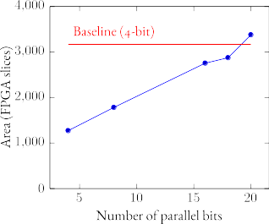
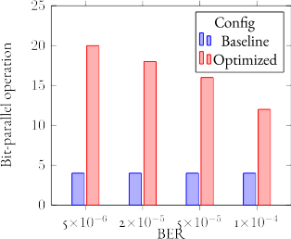
Increasing Throughput
Fit more powerful optimized decoder in area of baseline decoder
Find highest bit-parallel level of optimized decoder that fits within area of baseline decoder
Each channel within baseline decoder operates on 4 bits
Increasing bit-parallel capability of each channel increases throughput, but grows area
Optimized version of decoder gives us plenty of headroom to grow!
300%-500% increase in throughput!

Slide 36
How Multi-Bit Increases Throughput
Computing error locator polynomial does not need to be modified for multi-bit support
Syndrome computation streams input data, limits throughput
Syndrome computation is typically performed via LFSR, which scales well to bit-parallel operation
Root solver streams error locations as output, limits throughput
Increasing Chien search to bit-parallel operation involves duplicating multipliers, muxes and registers
Including many multipliers lead to timing problems requiring register duplication, resulting in even more area
Our reduced root solver is simply an LFSR and extends well to bit-parallel operation

Slide 37
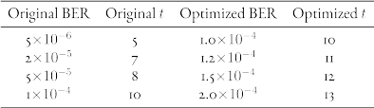
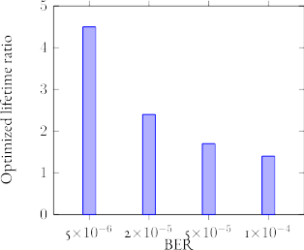
Extending Flash Lifetime
Optimization savings allow us to implement a more powerful decoder in the same area
Find optimized decoder with largest targeted Bit Error Rate (BER) that fits into the area of the baseline decoder
We can now support an increased lifetime for flash memory, whose error rate increases as it ages
We are able to achieve a 1.4x-4.5x increase in flash lifetime

Slide 38
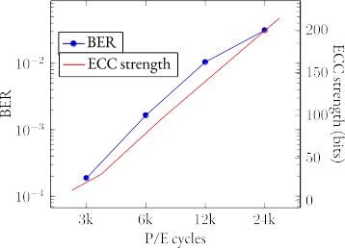
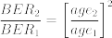
Flash Lifetime Background
P/E cycles cause flash memory to wear
Decreasing process sizes cause wear to happen sooner
Flash manufacturers recommend an ECC strength in bits to reach a specified flash lifetime
ECC strength chosen is a trade-off based on decoder requirements
By providing more ECC strength in a same sized decoder, we can change that trade-off
Cai et al. (2012) shows age/BER generally follows the relation:

Slide 39
Conclusions
We examined possibilities for improving multi-channel BCH decoders
By allowing a 2% performance degradation, we experienced massive gains, 47%-71% area savings, 44%-59% dynamic power savings.
We can fit faster and more powerful optimized decoders in the same area of the baseline decoder
3x-5x increase in throughput
1.4x-4.5x increase in flash lifetime

Slide 40

Questions?

